Slide 1

Sales Analysis Dashboard

Slide 2
Topics
Introduction
Key Findings
Actionable
Methodologies
Approaches
Insights
Dashboards
Conclusion

Slide 3
Introduction
The Sales Analysis Dashboard Provides A Comprehensive Evaluation Of Business Performance By Analyzing Key Sales Metrics, Customer Behavior, Product Trends, And Regional Success.
The Dashboard Highlights Top-performing Products, Identifies High-value Customers, Evaluates Shipping Efficiency, And Assesses The Impact Of Discounts On Profitability.
With Interactive Charts And Detailed Insights, This Tool Helps Organizations Make Data-driven Decisions To Optimize Sales Strategies, Improve Operational Efficiency, And Maximize Revenue Growth.

Slide 4
Key Findings
Extracting Distinct Values From Categorical Columns.
Designed Column Charts Using Top N Filters To Showcase The Top 10 Values
Tabular Representation Of Min And Max Values For Each Numerical Column
Analyzing The Distribution Of Each Numerical Column With Histograms
Seasonal Trends And External Factors Might Be Influencing Month-over-month Profit Variations.

Slide 5
Actionable
Use A Correlation Coefficient To Measure The Strength And Direction Of The Relationship Between Sales And Profit.
Look For Seasonal Patterns In Sales And Profit To Forecast Future Performance.
Visualize Missing Data Patterns To Identify Any Systematic Absence Across Certain Variables.
Use A Scatter Plot Or A Matrix To Compare Different Profit And Sales Bins Side-by-side.“
Segment Sales And Profit Data By Region Or Team To Identify High-performing Areas.

Slide 6
Insights
Certain Categories Show Higher Profit Margins, Providing Opportunities For Focused Marketing Strategies.
Certain Categories Show Higher Profit Margins, Providing Opportunities For Focused Marketing Strategies.
Discounts Influence Sales Volume, But Excessive Discounting Impacts Overall Profit Margins.
Sales Are Stronger In Certain Regions/Cities, Offering Potential Areas For Regional Marketing Focus Or Expansion.
Some Products Are Consistently Top Performers, While Others Underperform And May Need Further Marketing Efforts

Slide 7
Approaches
Import And Clean Data.
Create Dax Measures For Key Metrics.
Use Cards, Charts, And Line Graphs For Visuals.
Add Filters And Slicers For Interactivity.
Enable Drill-down For Detailed Views.
Add Filters For Time, Region, Or Product To Make The Dashboard Interactive.
Allow Users To Click For Detailed Views Of Specific Data Points.

Slide 8
Methodologies
Import And Clean Data.
Create Dax Measures For Key Metrics.
Use Cards, Charts, And Line Graphs For Visuals.
Add Filters And Slicers For Interactivity.
Enable Drill-down For Detailed Views.
Add Filters For Time, Region, Or Product To Make The Dashboard Interactive.
Allow Users To Click For Detailed Views Of Specific Data Points.

Slide 9
DASHBOARDS

Slide 10
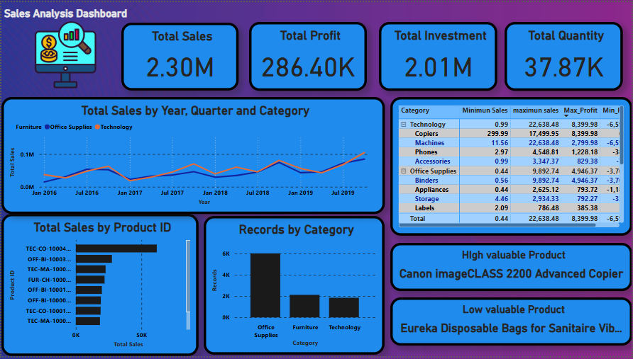

Slide 11
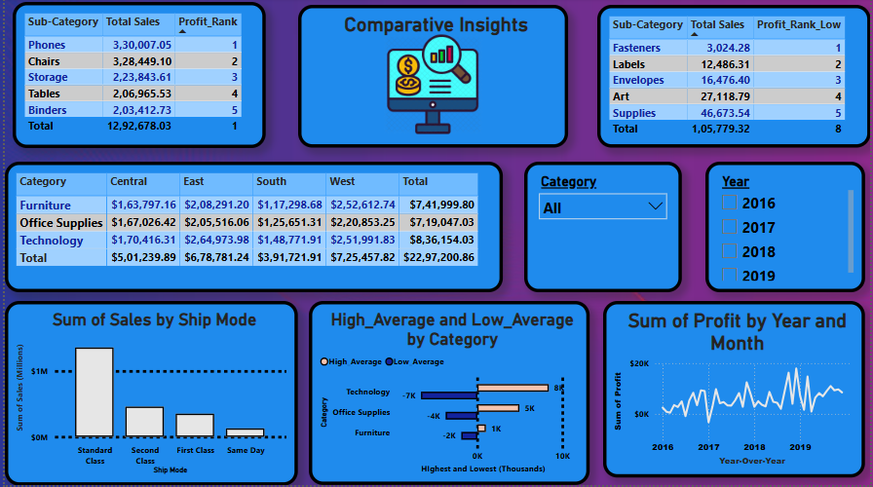

Slide 13
Conclusion
The Sales Analysis Dashboard evaluates business performance by analyzing key sales metrics, customer behavior, and product trends. It highlights top-performing products, high-value customers, and the impact of discounts on profitability. Insights reveal that certain categories have higher profit margins, while excessive discounting reduces overall profits. Interactive charts and filters enhance data-driven decision-making. Identifying seasonal trends and segmenting sales data helps refine strategies. This tool ultimately optimizes sales performance and strategic planning.

